Slide 1
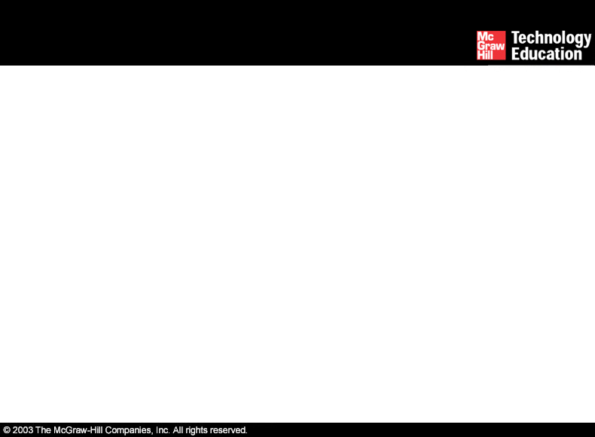
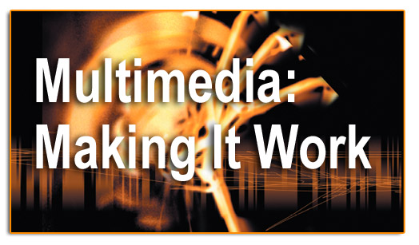
Lesson 10-Basic Software Tools

Slide 2
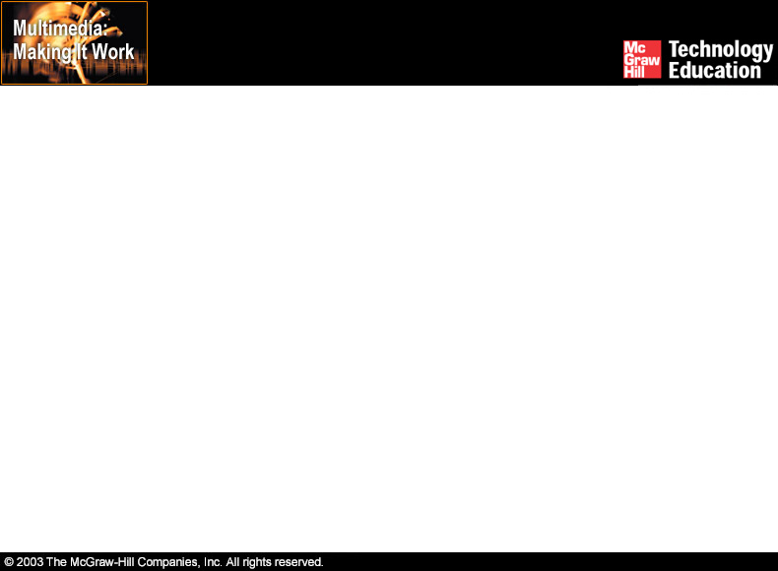
Overview
Text-based editing tools.
Graphical tools.
Sound editing tools.
Animation, video, and digital movie tools.
Video formats.
Utilities useful for multimedia.

Slide 3
Text-based Editing Tools
Word processors:
  Are powerful applications that include spell checkers, table formatters, thesaurus, and pre-built templates for commonly used documents.
  Are used for creating project letters, invoices, and storyboards.
  Allow embedded multimedia elements.

Slide 4
Text-based Editing Tools
Word processors (continued):
  Microsoft Word and WordPerfect are Word processors.
  Often come bundled in an "Office Suite."

Slide 5
Text-based Editing Tools
Optical Character Recognition (OCR) software:
  Converts bitmapped characters into electronically recognizable ASCII text.
  Makes use of probability and expert system algorithms.
  Is very accurate and saves time and effort.

Slide 6
Graphical Tools
Painting and drawing tools.
3-D modeling tools.
Image editing tools.

Slide 7
Painting and Drawing Tools
Most graphic programs use bitmapped images since they provide the greatest choice.
Include the Eyedropper tool, Autotrace tool, and anti-aliasing, airbrushing, blending, and masking functionalities.
PhotoShop, Fireworks, and Painter are painting software.
CorelDraw, FreeHand, and Illustrator are drawing software.

Slide 8
Painting and Drawing Tools
Features include:
  An intuitive graphical user interface.
  Scalable dimensions.
  Multiple undo capability.
  Scalable text font support.
  Support for third-party special effect plug-ins.
  Layering capability.

Slide 9
3-D Modeling Tools
Features include (continued):
  Good color and palette management.
  Multiple dimension windows and unlimited cameras.
  Lathe and extrude features.
  Ability to drag and drop primitive shapes, sculpt organic objects.
  Color and texture mapping.

Slide 10
Image-Editing Tools
Are specialized and powerful tools for enhancing and retouching existing bitmapped images.
Features include conversion of image-data types and file formats, masking features, employment of virtual memory scheme, etc.
Support third-party plug-ins.

Slide 11
Sound Editing Tools
Enables the user to see music as well as hear sound.
This is done by drawing a representation of sound in fine increments.
Enable the user to create custom system beeps.
System beeps are pre-packaged sounds that indicate an error, warning or special user activity.

Slide 12
Animation, Video, and Digital Movie Tools
Animation is a sequence of bitmapped graphic scenes or frames, rapidly played back.
Animations can be made within some authoring systems by moving objects or sprites to simulate motion.
Moviemaking tools take advantage of QuickTime and AVI formats to create, edit, and present digitized motion video segments.

Slide 13
Animation, Video, and Digital Movie Tools
Digital video editing and playback require a large amount of free disk space.
When working with digital video, it is necessary to defragment and optimize the disk before recording and playing back movie files.
It is necessary to compress movie files before delivery.

Slide 14
Animation, Video, and Digital Movie Tools
Compression ratio is the size of the original image divided by the size of the compressed image.
Compression can by lossy or lossless.
Lossy schemes ignore picture information the viewer may not miss.
Lossless schemes preserve the original data precisely.

Slide 15
Video Formats
QuickTime:
  Is a software-based architecture for integrating sound, text, animation, and video on Macintosh and Windows platform.
  Is an extensible system for multimedia delivery.
  Can deliver 3-D animations, virtual reality, and streaming audio-video on the Web.
  The three QuickTime elements are Movie file format, Media Abstraction Layer, and Media services.

Slide 16
Video Formats
QuickTime (continued):
  Includes built-in support for ten different media types.
  Offers a comprehensive set of services.
  Allows embedded commands in HTML documents.

Slide 17
Video Formats
Audio Video Interleaved (AVI):
  Is a Microsoft-developed format for playing full-motion interleaved video and audio sequences in Windows.
  Does not require specialized hardware.
  Is an inextensible, open environment.
  Lacks serious video editing features.
  The OpenDML format was developed to make AVI more functional.

Slide 18
Video Formats
QuickTime and Audio Video Interleaved (AVI) formats support special algorithms, provide a methodology for interleaving, and allow organized streaming of data from disk into memory.
Digital Versatile Disc (DVD) is a hardware format that uses laser light to store and read digital information.

Slide 19
Utilities Useful For Multimedia
Screen-grabber - Enables the user to move bitmapped images by placing them on the clipboard.
Format converters - Useful for projects where the source material originates on different platforms.

Slide 20
Summary
Word processors and OCR software are used to handle text in multimedia.
Painting and drawing tools, 3-D modeling tools, and image editing tools manipulate the graphical content of the project.
QuickTime for Macintosh and AVI for Windows are the two most widely used video formats.

